Slide 1
Growing Toward Maturity
A Study of the Epistle of James
Outline by Warren Wiersbe

Slide 2
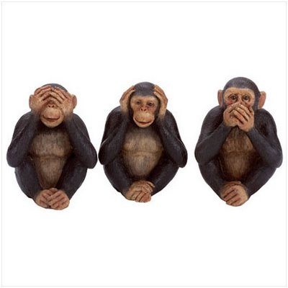
Monkey See, Monkey Do?

Slide 3
The Mature Christian receives the Word, Practices the Word and Shares the Word.
Spiritual Life Principle:

Slide 4
Receive the Word of God.
Five Steps to Receive the Word:
Be Quick to Listen.
Be Slow to Speak.
Be Slow to Anger. Because the Anger of Man does not achieve the righteousness of God.
Put aside all Impurity.
Walk in Humility.

Slide 5
Practice the Word of God.
The Danger of Religiosity.
The Quality of the Mirror.
The Honest Evaluation of the Mirror’s Reflection.
The Earnest Application of the Mirror’s Revealed Truths.

Slide 6
Share the Word of God.
Contrast of Religiosity and Real Religion.
Modern Day Phariseeism and Self-Deception.
Pure, Undefiled Religion: That which renders service to the truly needy.
Serve Amid Filth and Remain Unstained.

Slide 7
Spiritual Life Principle Application:
1 John 3:18, “Love in Deed and Truth.”
Mature Christians don’t hide out with the Word of God. They LIVE out the Word of God that has been implanted into them. They Receive it, they Practice it and they Share it.

