Slide 1
How Do You See Yourself?
Psalm 8

Slide 2
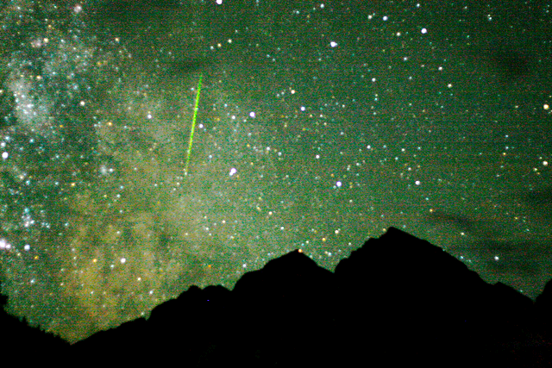

Slide 3
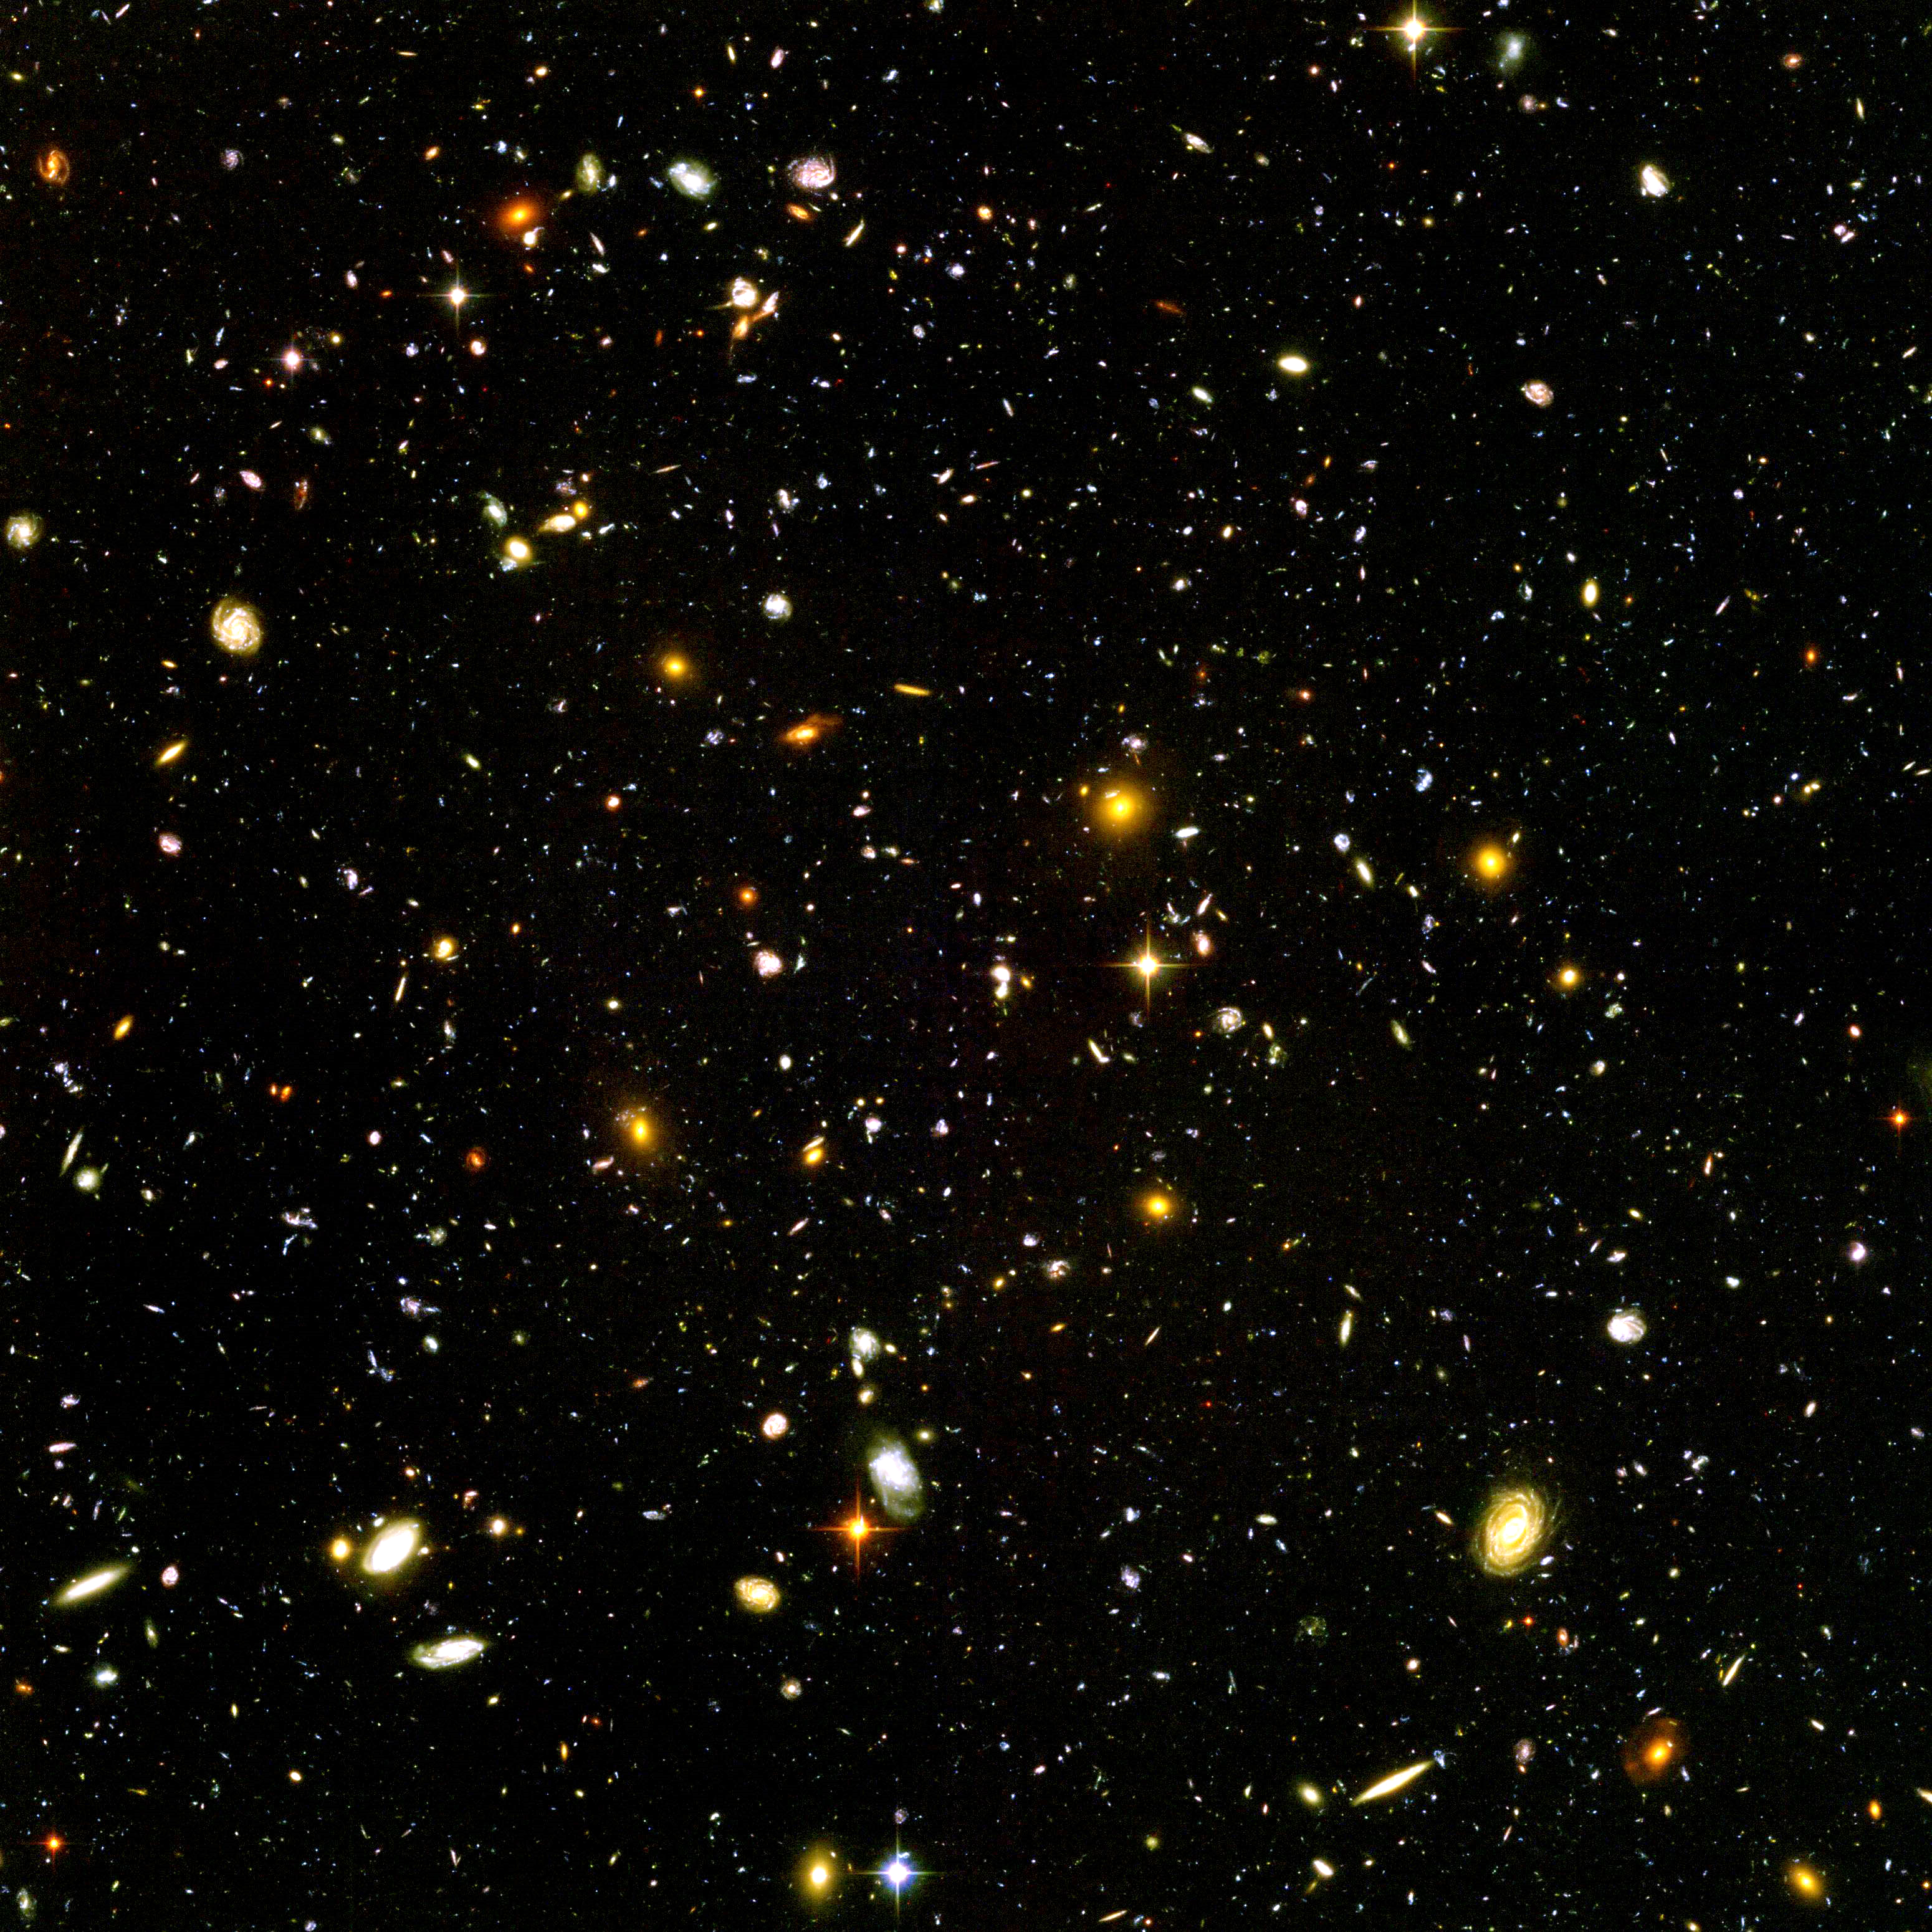

Slide 4
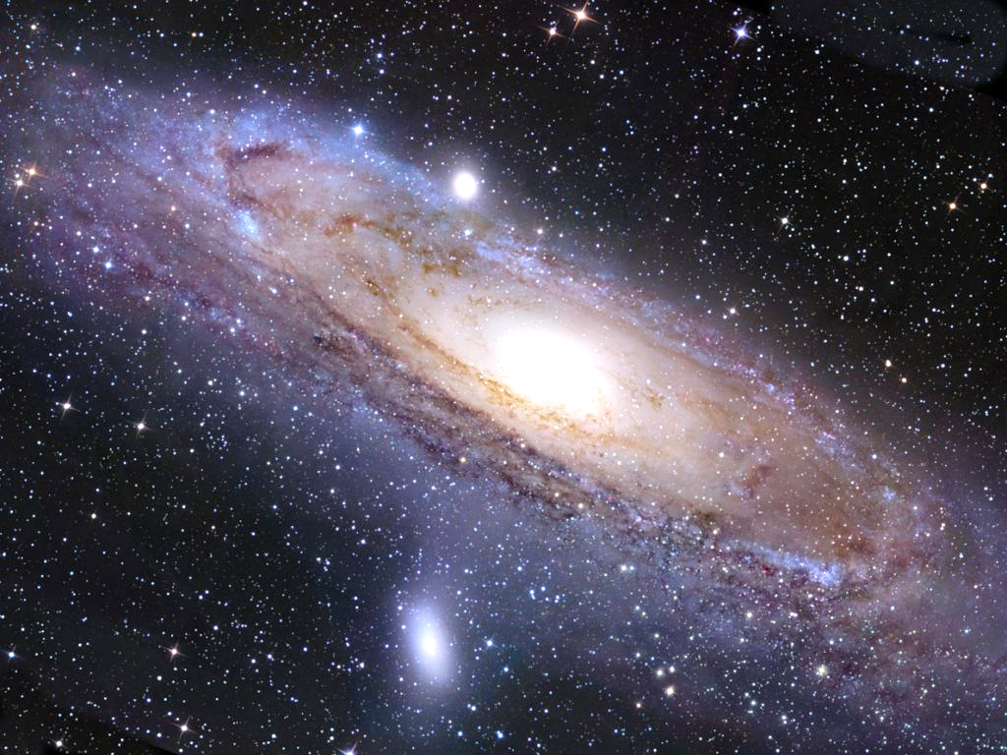

Slide 5
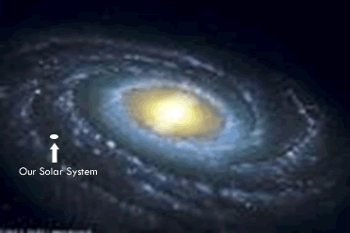

Slide 6
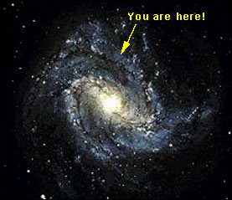

Slide 7
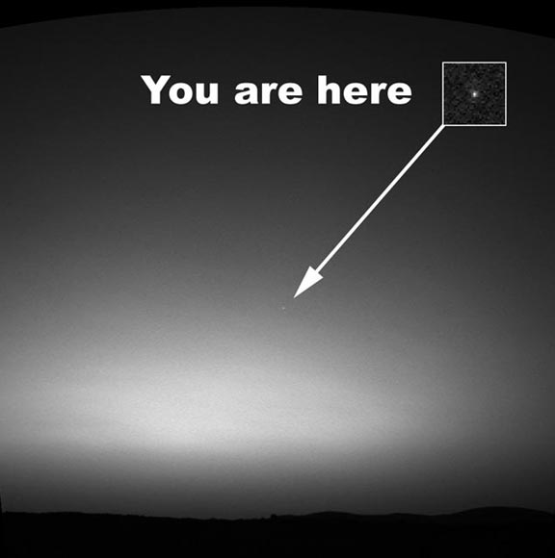
.

Slide 8
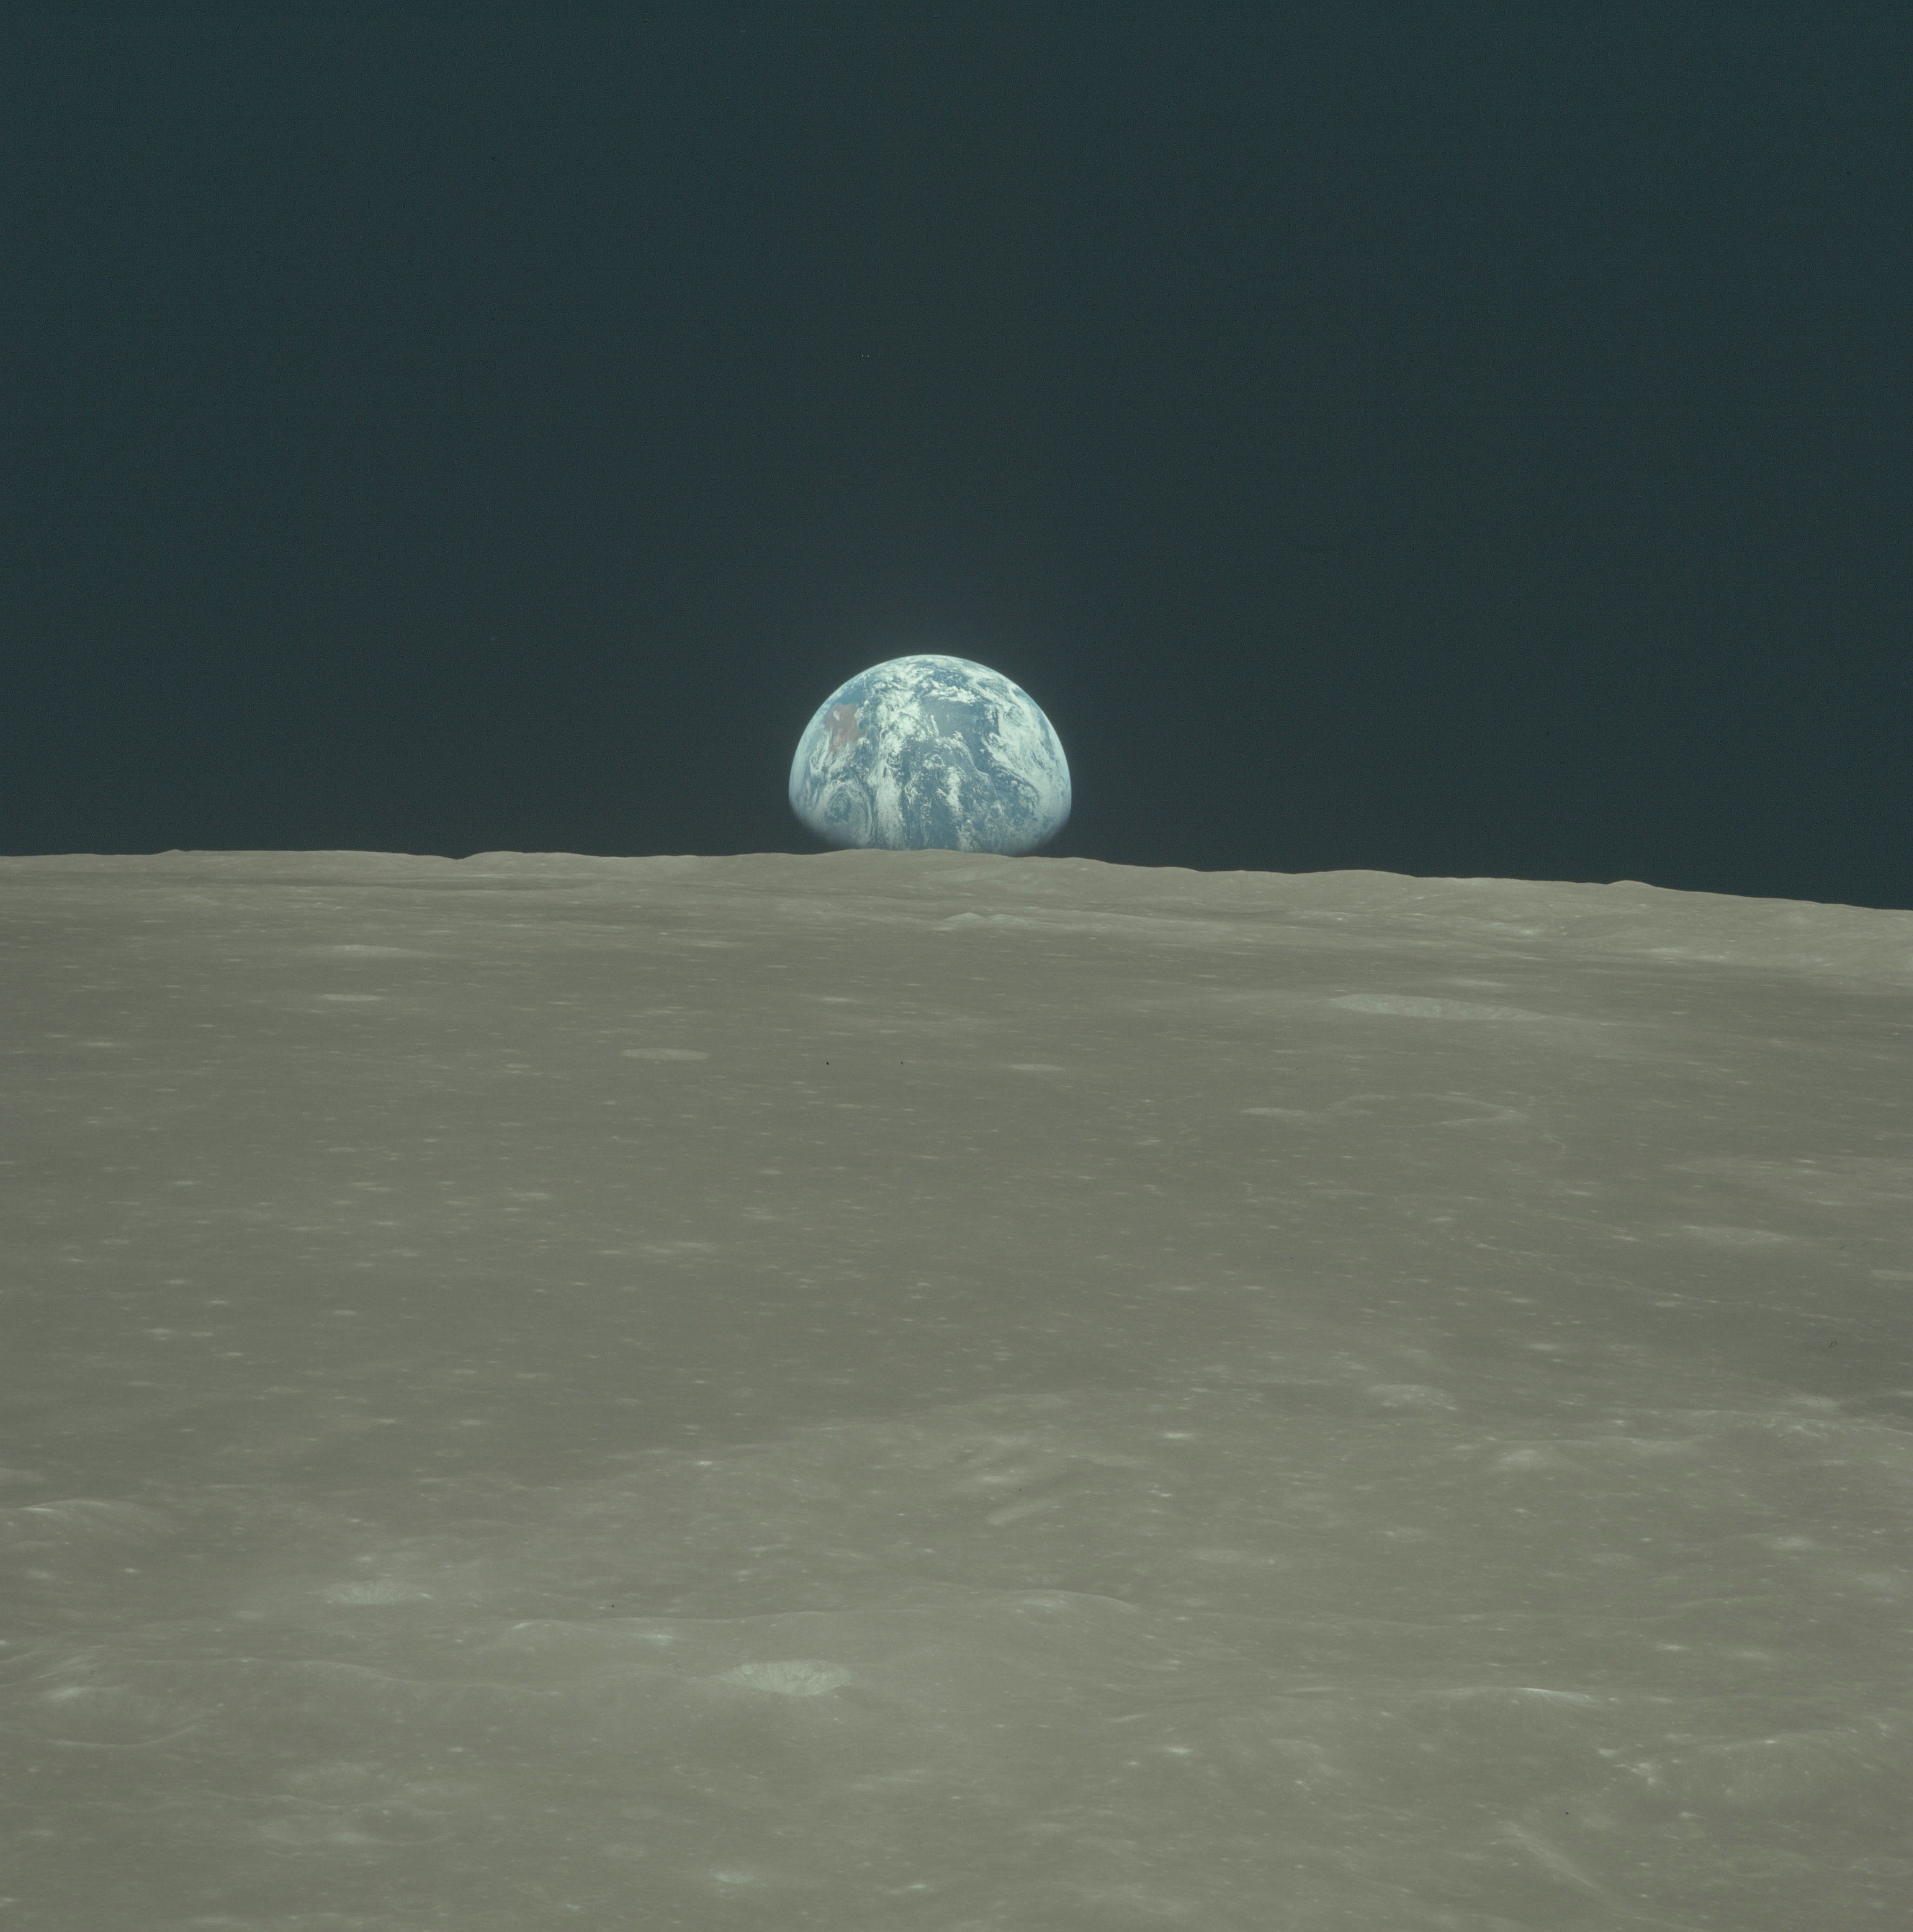

Slide 9
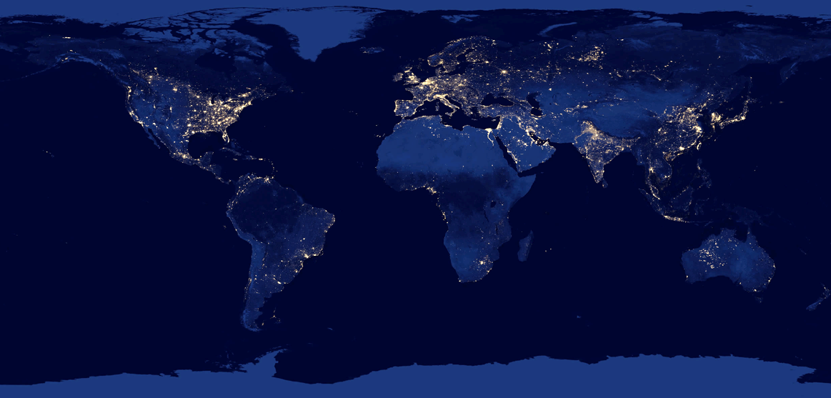

Slide 10
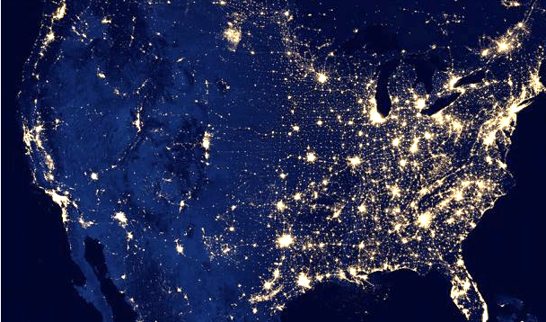

Slide 11
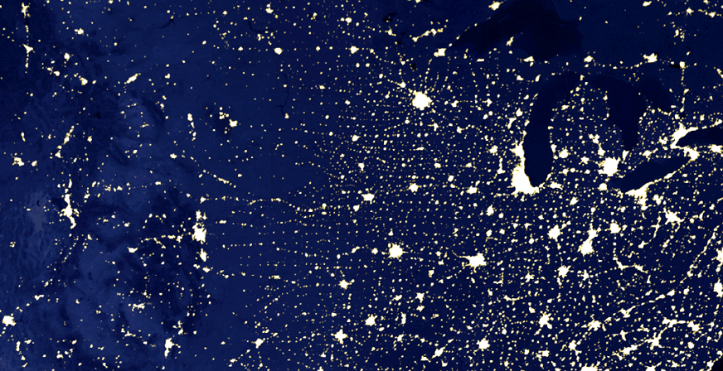

Slide 12
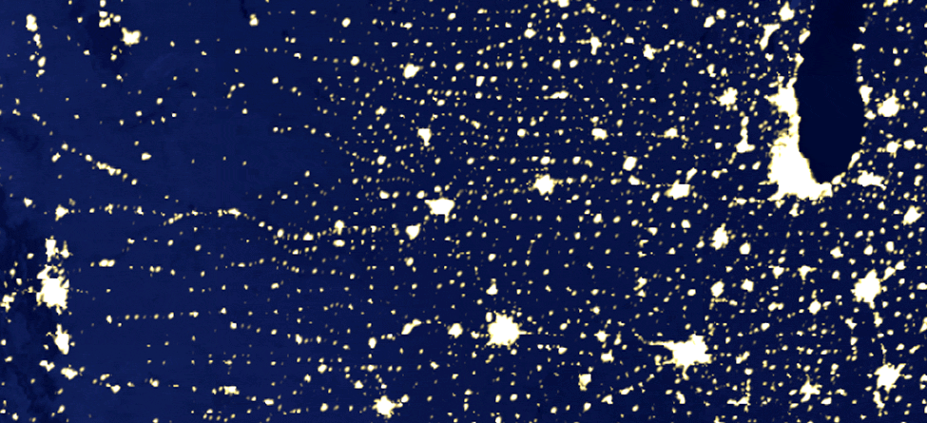

Slide 13
What is man that you take thought of him, and the son of man that you care for him?

Slide 14
Adam, and you, and I are not gods; but we are God-like.

Slide 16
A correct view of God begins with a correct view of Jesus Christ who came to reveal God to us.

Slide 17
O LORD, our Lord, how majestic is your name in all the earth!

